Slide 1
What is plot?
Plot is the literary element that describes how fictional stories are usually organized.
Notes:
Plot is the literary element that describes the structure of a story. A plot diagram is an organizational tool, which is used to map the significant events in a story. By placing the most significant events from a story on the plot diagram, you can visualize the key features of the story.

Slide 2



Types of Linear Plots
Plots can be told in
Chronological order
Flashback
In media res (in the middle of things) when the story starts in the middle of the action without exposition
Notes:
In addition, you can note that some stories follow a circular or episodic plot, and hypertextual stories can be different every time they’re read, as the reader chooses the direction that the story takes. If a story that students are working on does not fit into the triangle structure, think about why the author would choose a different story structure and how the structure has changed.

Slide 3
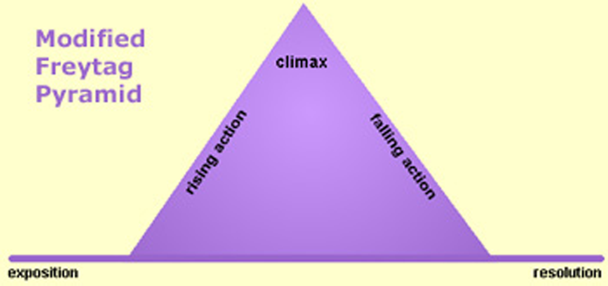
Freytag’s Plot Diagram
Notes:
Some readers find Freytag’s Pyramid is oversimplified. As a result, Freytag’s Pyramid is often modified so that it extends slightly before and after the primary rising and falling action. You might think of this part of the chart as similar to the warm-up and cool-down for the story.

Slide 4

Components of Plot
Rising Action: events focus on the conflict or problem.
Exposition: introduced to characters and setting (warm-up)
Notes:
Exposition: The mood and conditions existing at the beginning of the story. The setting is identified. The main characters with their positions, circumstances and relationships to one another are established. The exciting force or initial conflict is introduced. Sometimes called the “Narrative HOOK” this begins the conflict that continues throughout the story.
Rising Action: The series of events, conflicts, and crises in the story that lead up to the climax, providing the progressive intensity, and complicate the conflict.
Climax: The turning point of the story. A crucial event takes place and from this point forward, the protagonist moves toward his inevitable end. The event may be either an action or a mental decision that the protagonist makes.
Falling Action: The events occurring from the time of the climax to the end of the story. The main character may encounter more conflicts in this part of the story, but the end is inevitable.
Resolution/Denouement: The tying up of loose ends and all of the threads in the story. The conclusion. The hero character either emerges triumphant or is defeated at this point.

Slide 5
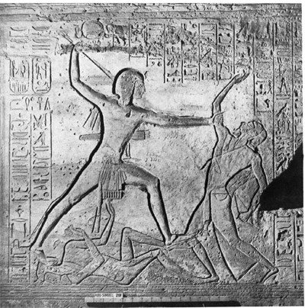
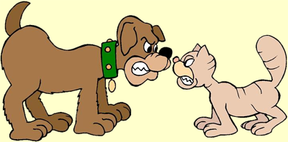
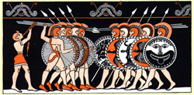
Conflict
Conflict is the dramatic struggle between two forces in a story. Without conflict, there is no plot.

Slide 6
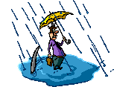

Types of Conflict
External Conflict
Character vs. Character
Character vs Nature
Character vs Society
Internal Conflict
Character vs Self

Slide 7
Components of Plot
Climax: the turning point, when the focus switches from the problem to the solution.
Falling Action: focuses on solving the problem
Rising Action: events focus on the conflict or problem.
Exposition: the part of the story where you are introduced to characters and setting (warm-up)
Resolution: the conclusion where the problem is solved or determined unsolvable
Notes:
Exposition: The mood and conditions existing at the beginning of the story. The setting is identified. The main characters with their positions, circumstances and relationships to one another are established. The exciting force or initial conflict is introduced. Sometimes called the “Narrative HOOK” this begins the conflict that continues throughout the story.
Rising Action: The series of events, conflicts, and crises in the story that lead up to the climax, providing the progressive intensity, and complicate the conflict.
Climax: The turning point of the story. A crucial event takes place and from this point forward, the protagonist moves toward his inevitable end. The event may be either an action or a mental decision that the protagonist makes.
Falling Action: The events occurring from the time of the climax to the end of the story. The main character may encounter more conflicts in this part of the story, but the end is inevitable.
Resolution/Denouement: The tying up of loose ends and all of the threads in the story. The conclusion. The hero character either emerges triumphant or is defeated at this point.

Slide 8
The Three Little Pigs
Once upon a time there were three little pigs, and the time came for them to leave home and seek their fortunes. Before they left, their mother told them, "Whatever you do, do it the best that you can because that's the way to get along in the world.”
The first little pig built his house out of straw because it was the easiest thing to do.
The second little pig built his house out of sticks. This was a little bit stronger than a straw house.
The third little pig built his house out of bricks.

Slide 9

Where are we on the PLOT Diagram?
Climax:
Here’s a solution to my problem!
Rising Action:
Falling Action:
Events are focused
around the conflict.
Carrying out the solution.
Resolution
Exposition
All done!
Opening of a story / background

Slide 10
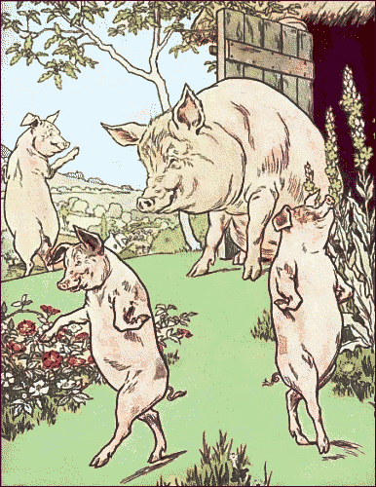
One night, the big bad wolf, who dearly loved to eat fat, little piggies, came along and saw the first little pig in his house of straw. He said, "Let me in! Let me in, little pig, or I'll huff and I'll puff, and I'll blow your house in!"
"Not by the hair of my chinny chin chin," said the little pig. But, of course, the wolf did blow the house in and ate the first little pig.
The wolf then came to the house of sticks. "Let me in! Let me in,
little pig, or I'll huff and I'll puff, and I'll blow your house in!" "Not by the hair of my chinny chin chin," said the little pig. But the wolf blew that house in, too, and ate the second little pig.

Slide 11
Where are we on the PLOT Diagram?
Climax:
Here’s a solution to my problem!
Rising Action:
Falling Action:
Events are focused
around the conflict.
Carrying out the solution.
Resolution
Exposition
All done!
Opening of a story / background

Slide 12
HELP! The wolf is after me!!
Type of Conflict | Major conflict of Three Little Pigs?
Ch. vs. Ch
Ch. Vs. Nature
Ch. Vs. Society
Ch. Vs. Self

Slide 13
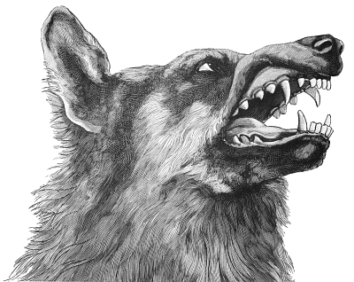
The wolf then came to the house of bricks. "Let me in! Let me in," cried the wolf, “or I'll huff, and I'll puff till I blow your house in!"
"Not by the hair of my chinny, chin chin," said the pig. Well, the wolf huffed and puffed, but he could not blow down that brick house. But the wolf was a sly old wolf, and he climbed up on the roof to look for a way into the brick house.
The little pig saw the wolf climb up on the roof and came up with an idea.

Slide 14
Where are we on
the
PLOT
Diagram?
Climax:
Here’s a solution to my problem!
Rising Action:
Falling Action:
Events are focused
around the conflict.
Carrying out the solution.
Resolution
Exposition
All done!
Opening of a story / background

Slide 15
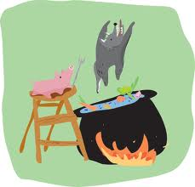
The little pig lit a roaring fire in the fireplace and placed on it a large kettle of water. When the wolf finally found the hole in the chimney, he crawled down and KERSPLASH, right into that kettle of water, and that was the end of his troubles with the big bad wolf.

Slide 16
Where are we on the PLOT Diagram?
Climax:
Here’s a solution to my problem!
Rising Action:
Falling Action:
Events are focused
around the conflict.
Carrying out the solution.
Resolution
Exposition
All done!
Opening of a story / background

Slide 17
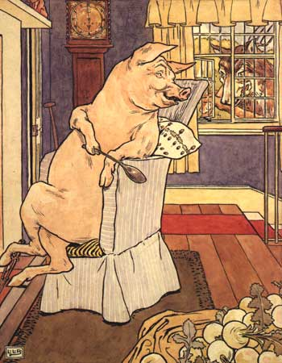
The next day the little pig invited his mother over . She said, "You see? It is just as I told you. The way to get along in the world is to do things as well as you can." Fortunately for that little pig, he learned that lesson. And he just lived happily ever after!

Slide 18
Where are we on the PLOT Diagram?
Climax:
Here’s a solution to my problem!
Rising Action:
Falling Action:
Events are focused
around the conflict.
Carrying out the solution.
Resolution
Exposition
All done!
Opening of a story / background

Slide 19
YOUR TURN!
PARTNERS: Review your plot diagram from “A Sound of Thunder” by Ray Bradbury.
  Would you keep answers the same? What would you change? Why?
INDEPENDENTLY: Work to REVISE your plot diagram from “A Sound of Thunder” to be turned in and graded for understanding of plot diagram and conflict.

